Slide 1
WEB APPLICATION DEVELOPMENT TRAINING
JAVASCRIPT – OBJECTS, MORE ON FUNCTIONS

Slide 2
JS Objects
An object is a collection of related data and/or functionality (variables and functions) which are called properties and methods when they are inside objects. In JavaScript, most things are objects
Just like any other thing in JS, creating an object often begins with defining and initializing a variable
Objects are variables too. But objects can contain many values
An object is made up of multiple members, each of which have a name (e.g. name and age above), and a value

Slide 3
JS Objects
The name and value is separated by a colon while each name/value pair must be separated by a comma.
var objectName = {
member1Name: member1Value, member2Name: member2Value, member3Name: member3Value }
When objects are created like this, they are referred to as object literal — we've literally written out the object contents as we've come to create it. This is useful if you want to transfer series of related data say into the database *
Notes:
More of this will be treated during jquery class
Objects may also be instantiated from classes

Slide 4
JS Objects
The value of an object member can be anything — it can be a string, a number, arrays, and even functions.
When the value are data items, they are referred to as properties, when it’s a function, it is referred to as the object's method.
The function allows the object to do something with the data items (properties)
var car = {type:"Fiat", model:"500", color:"white"};
Notes:
Properties of an object can even be another object, to access this nested objects, simply chain the dots

Slide 5
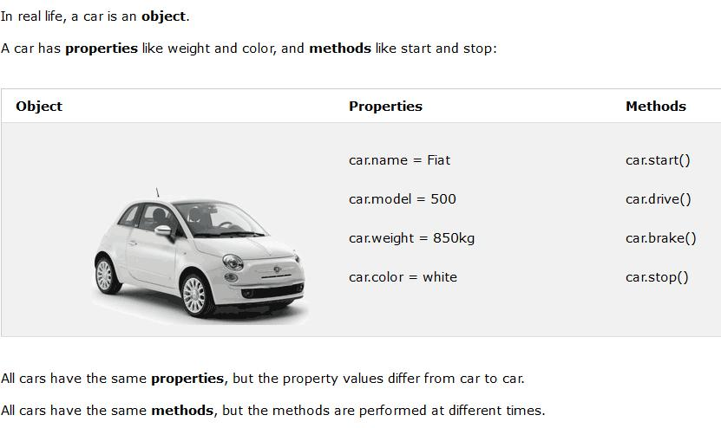
JS Objects

Slide 6
Example
var diet={breakfast:”bread”,lunch:”pounded yam”,dinner:”Rice”}
var person = {
firstName:"John",
lastName:"Doe",
age:50,
eyeColor:"blue“,
sayMyName: function() {return this.firstName + " " + this.lastName;}
};
Line breaks and spaces are not important in the definition

Slide 7
Accessing Object Properties
You can access the object's properties in two ways:
  objectName.propertyName *
  objectName["propertyName"]
person.lastName and person[“lastName”] will give us the same result
To access the object method, use objectName.methodName() eg person.fullname()
Accessing the function without () will return the function definition
Notes:
* This is called the dot notation

Slide 8
Accessing Object Properties
One useful aspect of bracket notation is that it can be used to set not only member values dynamically, but member names too.
Try this out *
This isn't possible with dot notation, which can only accept a literal member name, not a variable value pointing to a name
Notes:
* Allow users to be able to store custom value types in their people data, by typing the member name and value into two text inputs?

Slide 9
Assignment
Create an object definition for the car shown above
AB and M is a business registered in Lagos, the company has the following details:
The CEO’s name is “Ola”, one of the staff is named “Janet”, the company has 20 customers all brought in by Janet.
Write an object definition comprising of:
Company name, name of CEO, number of customers, staff name
Write a function that displays “Janet manages all our 20 customers”
The “I agree button”

Slide 10
Exercise
Write an object notation describing a person(your name) in the following ways:
The name, email address, favourite food, phone number
Write a function definition the person can use to greet people(assume everybody has their way of greeting people)
Call this function of person

Slide 11
The “this” keyword
The this keyword refers to the current object the code is being written inside
You have been using objects all along!
When you write:
  var mytext= “Ade is a boy”;
  mytext.replace(“boy”,”girl”);
You are actually calling the replace function in the String class

Slide 12
Sample Solution
var person= {
name: “olamide”,
email: “ ola@yahoo.com “ ,
phone: “080123456”,
favouriteFood: “Eba”,
slogan:function(){
return “No problem”;
}
greetings: function(){ return “what’s up?”;}
}

Slide 13
Javascript OOP Concept
objects are also commonly used as data stores that can be easily sent across the network
OOP JS is about defining an object template that can be re-used
It’s about creating a generic object that can be referenced and used
In some OOP languages, this generic object type definition is called a class but JavaScript uses a different mechanism and terminology, for it – it is not the actual object but it’s a template that defines the object

Slide 14
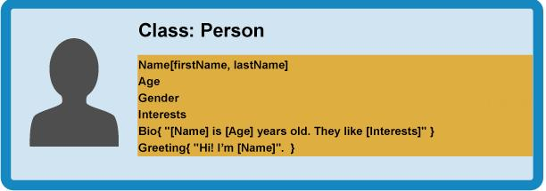
The generic object template of person
Notes:
From our class, we can create object instances — objects that contain the data and functionality defined in the class. From our Person class, we can now create some actual people:

Slide 15
Instantiation – Creating an actual object from the class
From our class, we can create object instances — objects that contain the data and functionality defined in the class.
From the Person class, we can now create some actual people.
The process of creating an object instance from a class is called instantiation

Slide 16
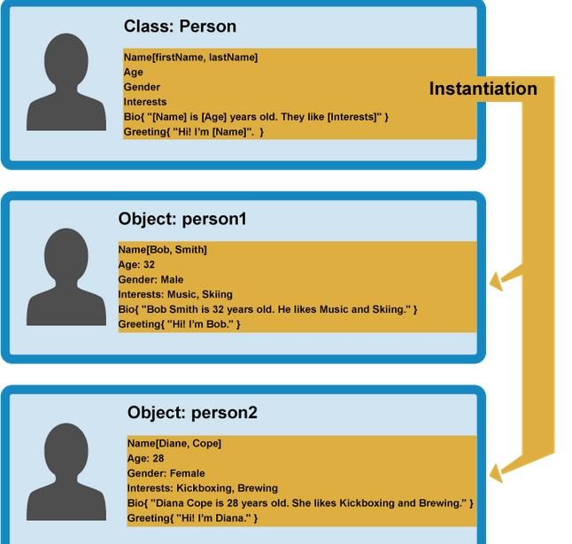

Slide 17
Instantiating an Object From A Class
Refer to the exercise in slide 10, imagine you have a generic definition that looks like thus:
function HumanBeing(name,email) {
this.name = name;
this.email = email;
this.slogan = function(){return “it is well”;}
this.greeting = function() {
alert('Hi! I\'m ' + this.name + '.');
};
}
The implication is that; you can define olamide as an object of the template (class) HumanBeing, more than that, you can define more objects like “lola”, “ade” etc

Slide 18
Instantiating an Object From A Class
Doing the above is referred to as instantiating an object from a class.
Notice that it is just like any other function but doesn't return anything — it basically just defines properties and methods.
The “this” keyword being used here is basically saying that whenever one of these object instances is created, the object's name property will be equal to the name value passed to the constructor call

Slide 19
Instantiating an Object From A Class
The class in js is referred to as a Constructor function
A constructor function name usually starts with a capital letter — this convention is used to make constructor functions easier to recognize in code.
To instantiate, do:
var handler = new ClassName(parameter);
Example is var human = new HumanBeing(“olamide ”,” ola@yahoo.com”);

Slide 20
Instantiating an Object From A Class
To call the function inside , now write human.greeting()

Slide 21
Other Things
setInterval() Method: The setInterval() method calls a function or evaluates an expression at specified intervals (in milliseconds). Syntax is setInterval(function(){}, time)
The setInterval() method will continue calling the function until clearInterval() is called, or the window is closed. Syntax is setTimeout(function, milliseconds);
form.submit;
Notes:
There are 1000 milliseconds is one second.

Slide 22
Other Things – The Date Object
Inbuilt JS object that is used to work with dates and times. Created with new Date()
To use the properties and methods of the date object, you must instantiate using any of the 4 ways below:
  var t = new Date();
  var t = new Date(milliseconds);
  var t = new Date(datestring);
  var t = new Date(year,month,day,hours,minutes,seconds,milliseconds)
Notes:
Exercis: Create a function that calculates the number of days left before your next birthday.

Slide 23
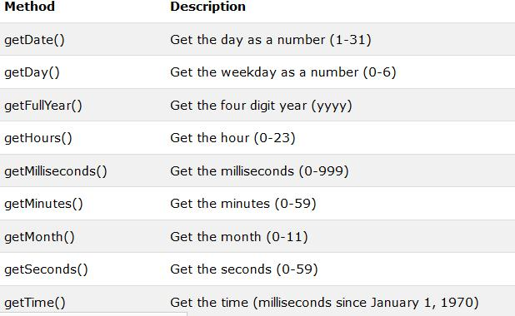
Date Methods
Notes:
Check https://www.w3schools.com/js/js_date_methods.asp

Slide 24
Javascript Date and Time
Var x = new Date();
Real time clock

Slide 25
Other Things – The Math Function
Notes:
Create a time real time
Number of days before your birthday.

